Slide 1
Introduction of Operating System
Deadlock Preventation
Group 1
On Wu Xu 2290113-DCS
Lim Yee Jie 2290025-DCS
Yap Kah Seng 2290146-DCS
Huai Zi Yao 2290085-DCS
Tan Thee Wei 2290107-DCS
Lee Mun Hinn 2270117-DCS

Slide 3
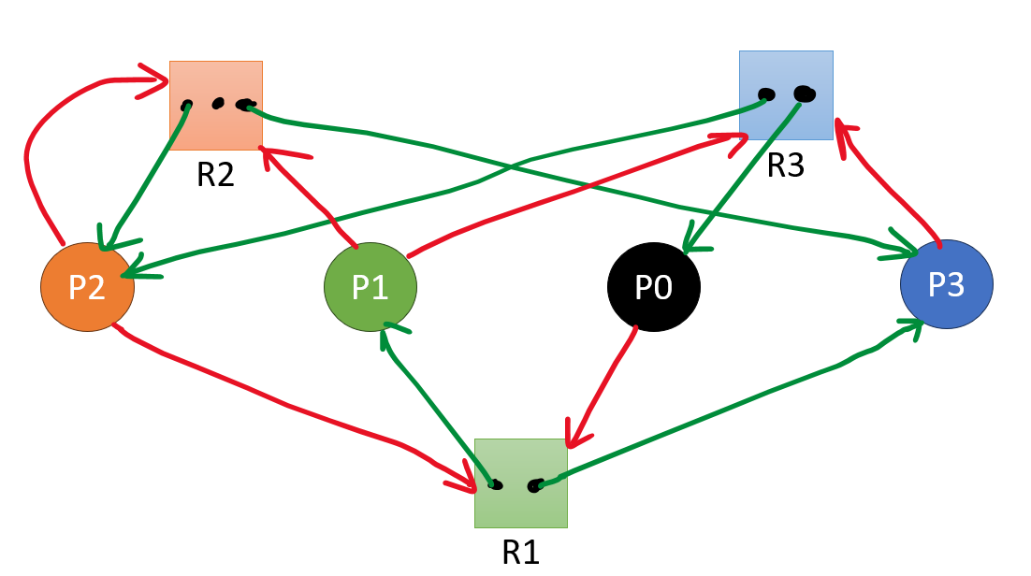
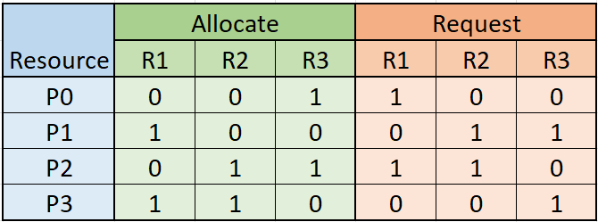

Slide 4
Total Instance = (R1,R2,R3)
= (2, 3, 2)

Slide 5
Total Instance = (R1,R2,R3)
= (2, 3, 2)
Total Allocate = (2, 2, 2)

Slide 6
Total Instance = (R1,R2,R3)
= (2, 3, 2)
Total Allocate = (2, 2, 2)
Total Allocate = (2, 2, 2)
Availability = (0, 1, 0)
NOT MATCH!! (DEADLOCK)

Slide 7
HOW TO SOLVE?

Slide 8
Solution 1: Give Extra Instance
Give one more Instance to R3

Slide 9
Solution 1: Give Extra Instance

Slide 10
Total Instance = (R1,R2,R3)
= (2, 3, 2+1)
= (2, 3, 3)
After MATCH P1,
Availability = (1, 1, 1)
Total Allocate = (2, 2, 2)
Availability = (0, 1, 1)
MATCH P1

Slide 11
After MATCH P1,
Availability = (1, 1, 1)
After MATCH P0,
Availability = (1, 1, 2)

Slide 12
After MATCH P1,
Availability = (1, 1, 1)
After MATCH P0,
Availability = (1, 1, 2)
After MATCH P2,
Availability = (1, 2, 3)

Slide 13
After MATCH P1,
Availability = (1, 1, 1)
After MATCH P0,
Availability = (1, 1, 2)
After MATCH P2,
Availability = (1, 2, 3)
After MATCH P3,
Availability = (2, 3, 3)

Slide 14
After MATCH P1,
Availability = (1, 1, 1)
After MATCH P0,
Availability = (1, 1, 2)
After MATCH P2,
Availability = (1, 2, 3)
After MATCH P3,
Availability = (2, 3, 3)

Slide 15
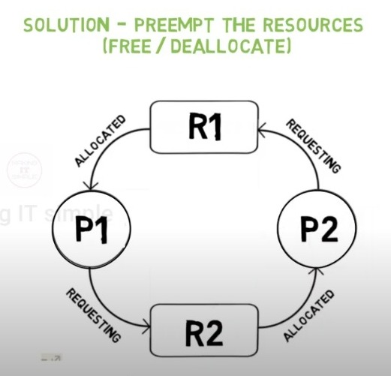
Solution 2: Preemption the Resources
Notes:
https://www.youtube.com/watch?v=xZdDAWpgxCg

Slide 16
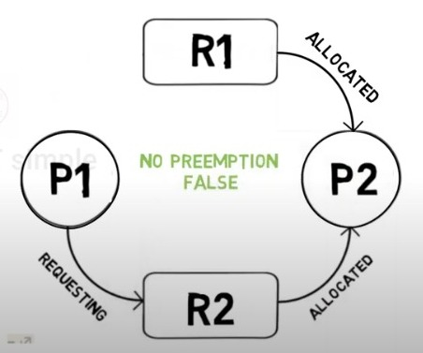

Slide 17
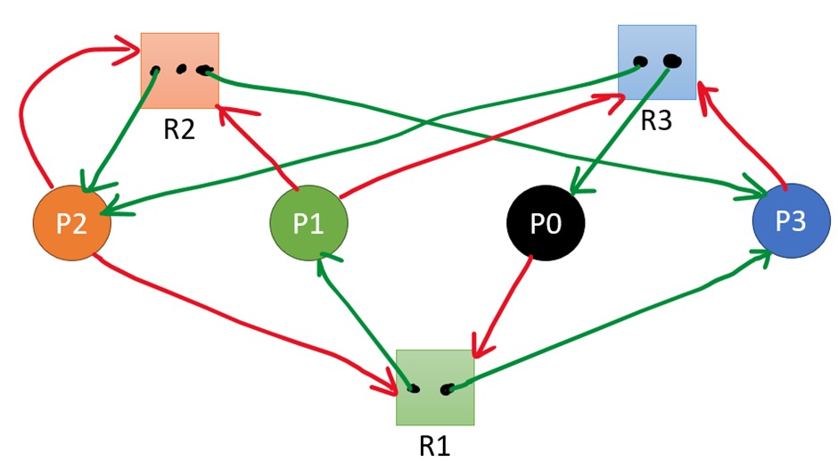

Slide 18
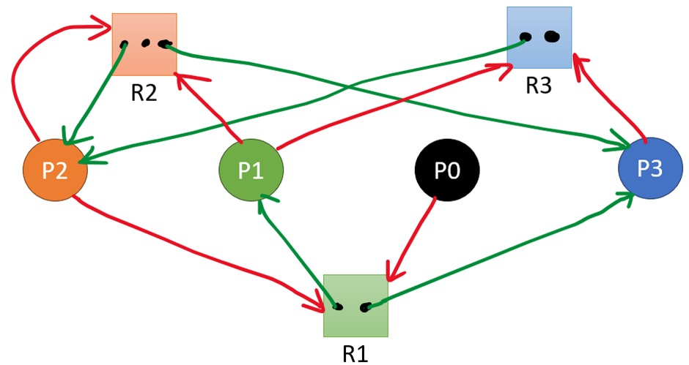

Slide 19
Solution 3: Circular Wait
Ways to solve problem:
Introduce resource priority
Timeout mechanism

Slide 20


